Slide 1

How to close the gender gap in tech industry and support women empowerment ?

Slide 2


Slide 3
Le cercle Interelles, c’est :
UN RÉSEAU DE RÉSEAUX DE FEMMES ET D’HOMMES D’ENTREPRISES ENGAGÉES POUR LA MIXITÉ DANS LE SECTEUR SCIENTIFIQUE ET TECHNOLOGIQUE
14 entreprises à métiers essentiellement scientifiques et techniques.
Plus de 10 000 femmes et hommes concerné.e.s par le travail en équipes mixtes.
17 ans d’échanges, de partage d’expériences, et de travaux en commun.
17 colloques (How to close the gender gap).
Plus de 50 thèmes traités depuis 2001.
La réalisation de boîtes à outils pour toutes et tous.

Slide 4
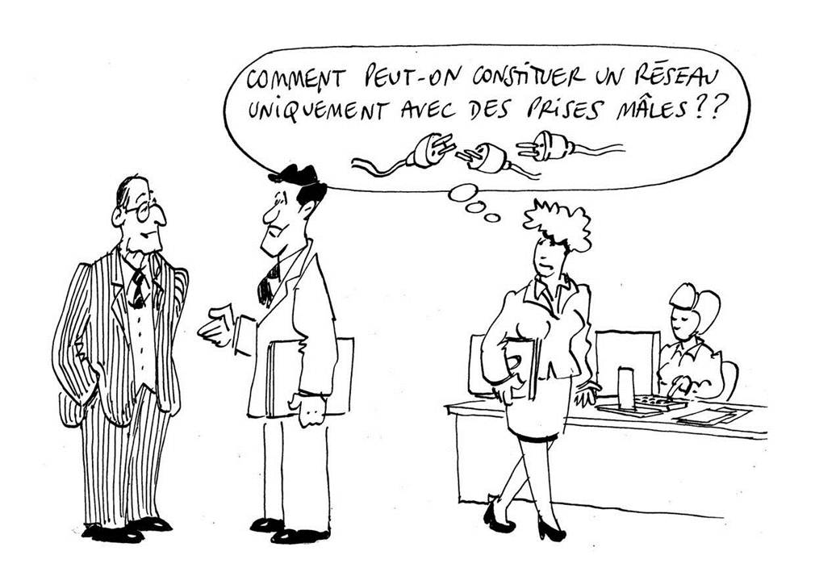

Why a network ?
Pourquoi un réseau ?

Slide 5


Why Focus on Women ?
on the board gain
(Catalyst study)
+73%
+83%
+112%
500
return on sales
return on equity
return on invested capital
Companies with a higher share of women at the executive committee level outperform those with less women
41%
56%
higher return on equity
better operating results
(McKinsey report)
The Eurozone could increase by
“Women’s economic empowerment is arguably the biggest social change of our times”
13%
16%
(Goldman Sachs)
9%
GDP
Japan
USA
(The Economist, 2010)
simply decreasing the gap in employment rates between women and men
*Women control 85% +/- of consumer purchases in the U.S.

Slide 6
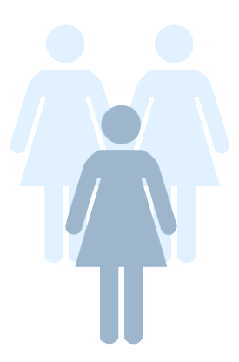
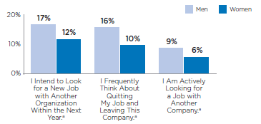
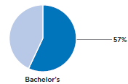
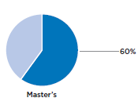
Businesses Thrive when Women Thrive
Stabilize the workforce
Global Economic Impact of $ 28 Trillion
Women leaders more engaged at work
If women play an identical role in labor markets to that of men by 2025.
Emerging Talent pool is Female
Enhanced innovation & productivity
Gender-balanced teams were most likely to experiment, be creative, share knowledge, and fulfill tasks found a survey of 1,400 members from 100 teams at 21 companies in 17 countries
Women make up more than 50% college graduates in US alone.

Slide 7
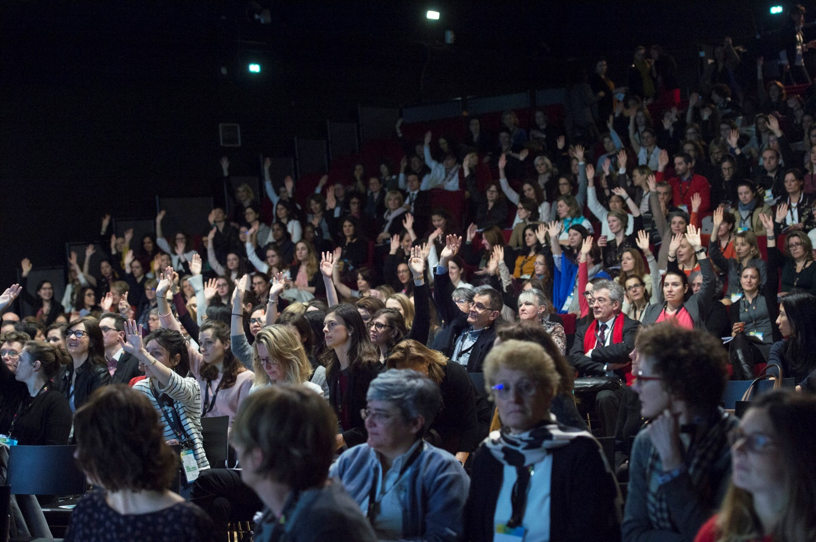

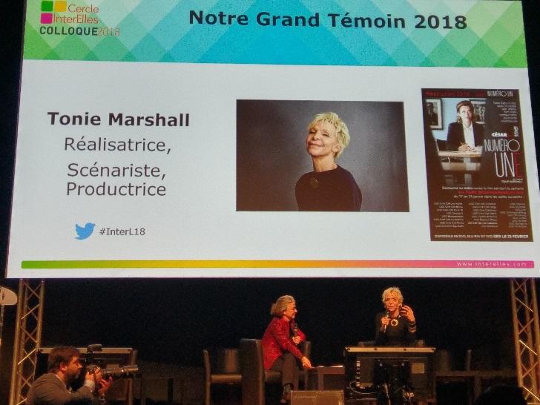
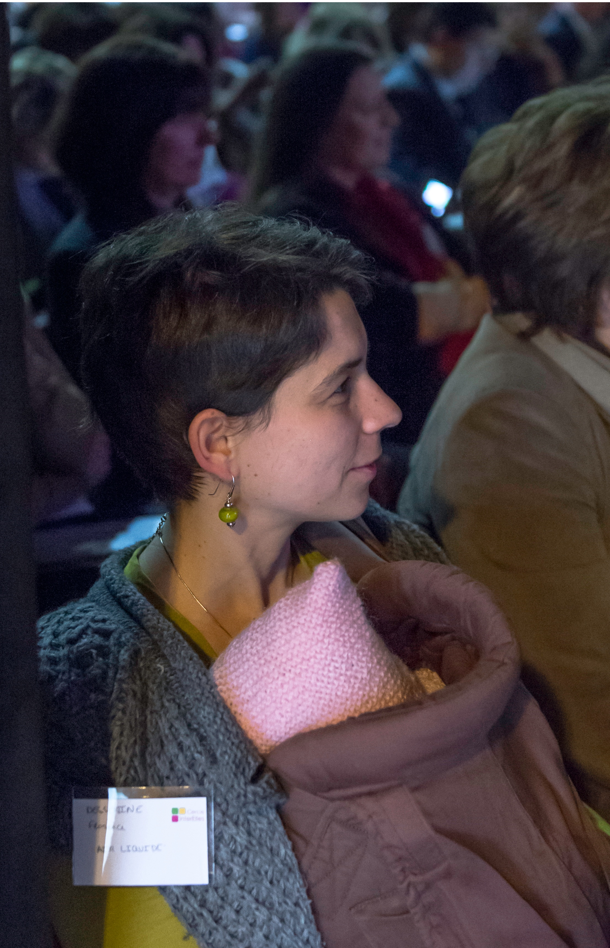
Les colloques

Slide 8
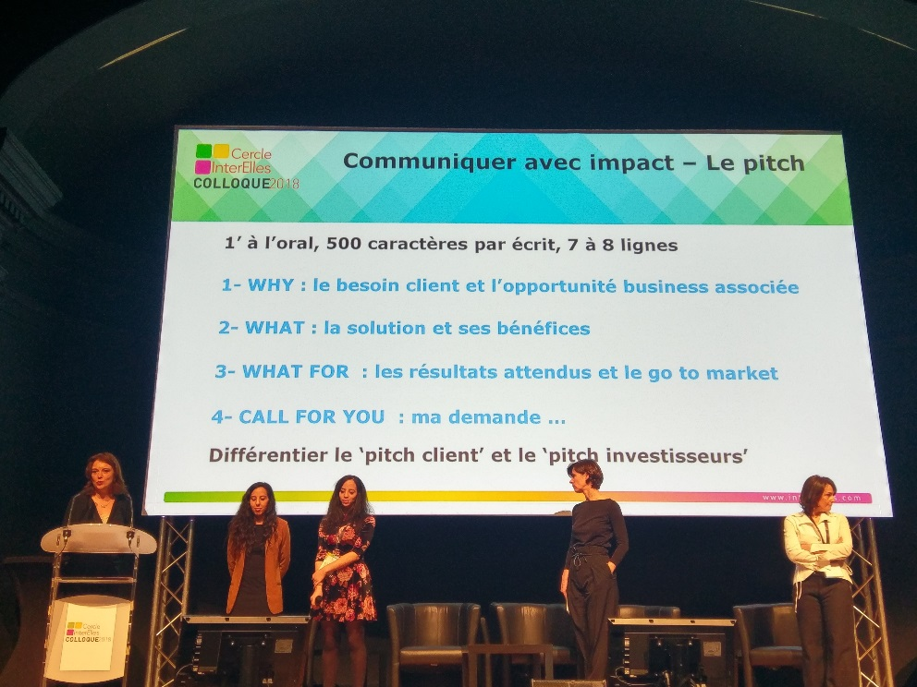
Our workshops : http://www.interelles.com/
Entreprises, écoles, universités : mêmes défis !
Le jeu des codes en entreprise
Femmes et sciences : ça commence à l’école
La mixité : pourquoi résister ?
Emotions et intuition
Codes masculins/féminins
Mon salaire parce que je le vaux bien !
Femmes et innovation, la nouvelle Odyssée
Management interculturel de l’égalité des chances
Mixité : des intentions à une réalité durable
La gestion des carrières en discontinu
Les femmes et le pouvoir
Femmes et technologies : au-delà des idées reçues
Défis et opportunités : expériences de femmes en Europe
…..

Slide 9

The Diversity Challenges
Share KPI for individual & collective awareness
Fight against the stereotypes and sexism
Through networking & solidarity, build women confidence and develop their leadership
Develop women contribution in innovation fields and future of work
Promote the CEO commitment

Slide 10
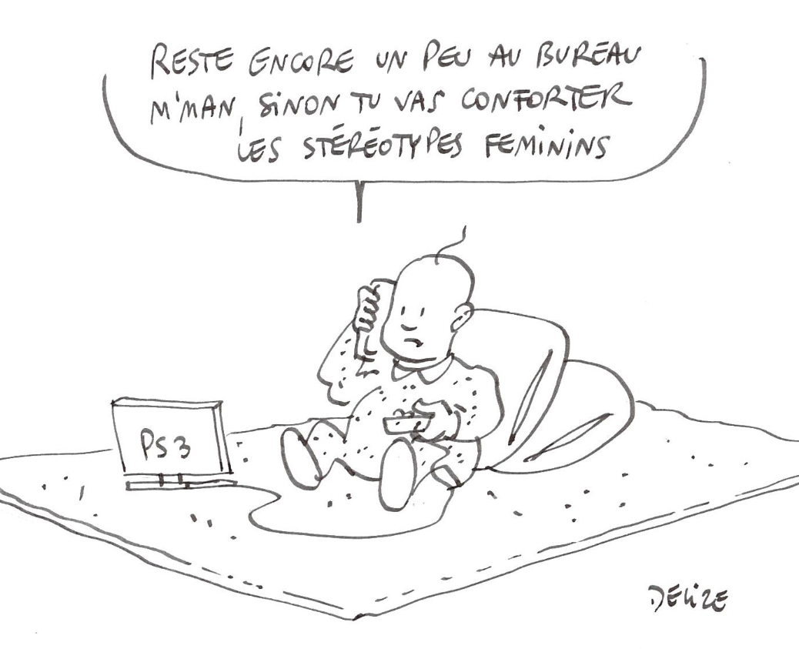
Unconscious Bias ?
Unconscious biases are embedded within all of us, often shaped over many years through education, culture, and experience.
To change our behavior, we need to make a conscious effort to identify and recognize these biases within ourselves.
If we don’t, then as individuals and collectively, we will make the same choices over and over again.
Notes:
Unconscious Bias at management level…
Senior managers agree about the need for diversity at leadership levels, however still fall back on unconscious beliefs when making final hiring and promotion decisions – the idea that it would be easier to align strategies behind people with similar backgrounds to themThe result is a management team with little diversity. Talent processes such as succession planning, leadership development, talent reviews and high potential programs should all be examined closely for these biases.
Stereotypes have become so ingrained that certain roles continue to be associated with people of one gender or a certain background, even when an objective assessment demonstrates these assumptions to be unfounded.
Some studies show men are assessed on their 'potential', while women are judged on 'performance'.

Slide 11
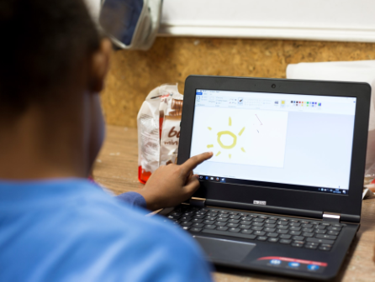
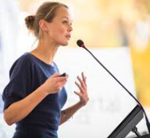
Challenging the Biases : how ?
Education – More active in STEM
Enterprise – Re-thinking talent hiring, development and coaching. Gender programmes
Society – Government action. More balanced media
Women – Re-connecting with ambitions. Ceasing the opportunities. Taking action.

Slide 12


A test for you ….
Combien de temps ?
Les conditions :
être très concentré, répondre très vite, en mode réflexe, sans réfléchir ...

Slide 13
A chacun son biais …
Séquence 1
Combien de temps ?
Dans la liste des 10 mots cités, indiquez à quelle catégorie chacun appartient :
HOMME FEMME

Slide 14
A chacun son biais …
Séquence 2
Combien de temps ?
Dans la liste des 10 mots cités, indiquez à quelle catégorie chacun appartient :
FAMILLE INNOVATION

Slide 15
A chacun son biais …
Séquence 3
Combien de temps ?
Dans la liste des 10 mots cités, indiquez à quelle catégorie chacun appartient :
HOMME OU INNOVATION FEMME OU FAMILLE

Slide 16
A chacun son biais …
Séquence 4
Combien de temps ?
Dans la liste des 10 mots cités, indiquez à quelle catégorie chacun appartient :
FEMME OU INNOVATION HOMME OU FAMILLE

Slide 17
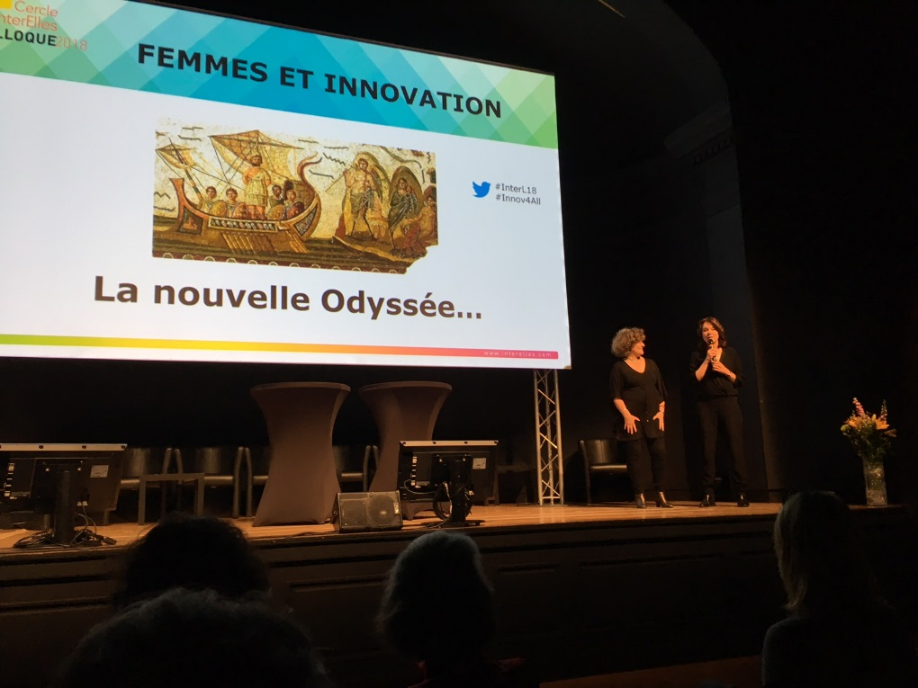
Women in Innovation : a new Odysseus ?

Slide 18
Worldwide figures…
Median level of innovation revenue (%)
Source :BCG Study 2017
  29% of international patent application cite at least one woman inventor
  Less than 20 % of French tech start-up have been founded by women
Limited presence of women in innovation processes : 35 % of people involved
Sources Baromètre Innovation IFOP / WIPO 2015 /Baromètres StartHer 2015
Share of women in management(%)
Nowadays : a necessary but limited presence…
…and a proved economical interest

Slide 19
OUR SURVEY 1 : what’s about innovation in our work ?
Approx. 500 respondents from our companies, including 26% men →
Men and women have the same desire to innovate (90% of respondents).
87% of men and 67% of women have the opportunity to innovate in their work
Women and men innovate mainly during working hours (75%), but women innovate more than men outside of working hours (13% vs 2%).
They face the same difficulties : difficulty to convince, limited access to external competences and support, fear of failure, lack of time
Women have more difficulties to negotiate budgets (23% vs 16%) and lack access to network of influential people (27% vs 20%).

Slide 20
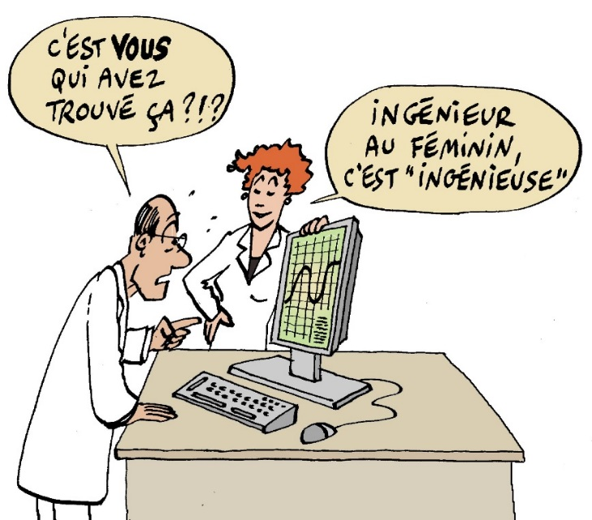
OUR SURVEY 2 : what’s about women in our patents?
5000 patent applications dated from 2017 from Cercle Interelles companies have been analyzed by us, i.e 14 500 inventors :
13% of cited inventors are women
80% of patents are filed by teams composed solely of men
The average rate of feminization in our patent sample is 9%

Slide 21
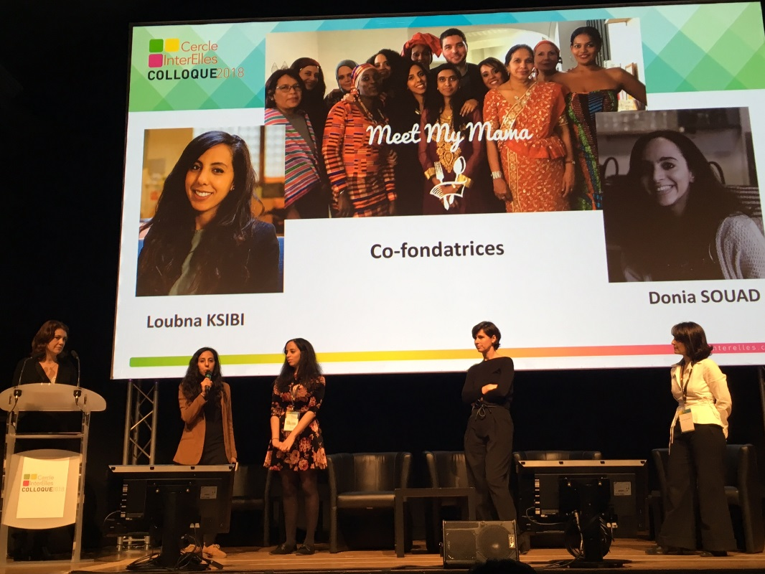
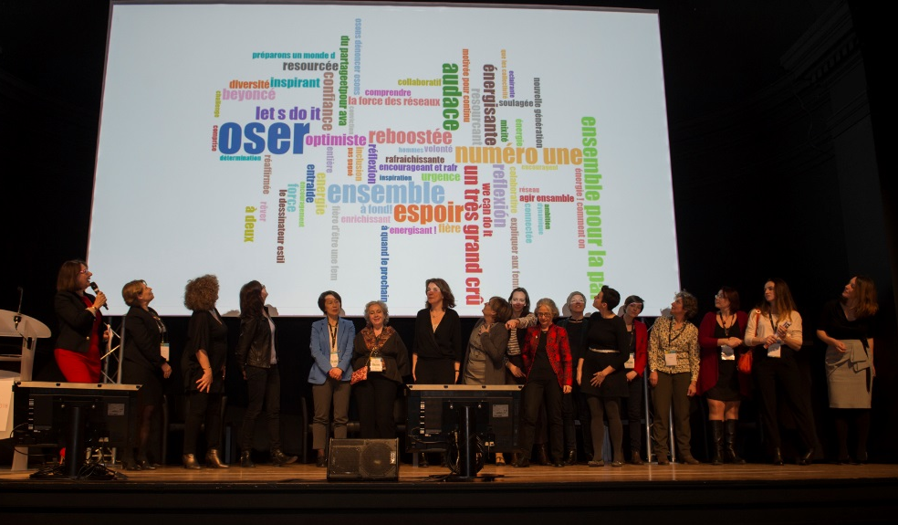
Women in innovation field…
Our requests
A personal testimonial

Slide 22
I ask my company to:
I ask my company to arrange places, time and management methods to innovate.
I ask my company to integrate the men and women component into the design of our products and projects
I ask my company to support women's networks.
I ask my company to give the floor to women.
I ask my company to identify the inventors / men and women / in its patent applications and to make regular gender assessments.
I ask my company to highlight inspiring and motivating female role models
I ask my company to put more women in leadership positions.
I ask my company to put more start-ups in touch with our research teams.

Slide 23
I am committed to:
I exceed my fear, I know that everyone can innovate. I dare to leave the traced tracks to discover new ones
I know that I can: doubt, deceive, choose, advance, succeed. My entourage also knows it and trusts me.
I commit myself to innovate in my daily life, get around obstacles, find new solutions and move forward
I don’t let anyone tell me that it is not possible
I commit myself to organize the "Design Thinking" sessions to help us manage the changes, and make sure everyone is asked for their ideas.
I'm going to a hackathon to learn about collective innovation processes: it's not limited to developers or technical trades.
I learn to “pitch” and “pitch” to convince.
I pledge to report the absence of women in innovation projects
I support a project I believe in on an innovation platform.

Slide 24
Spécial tools for you…
Is it for women only ?
NO : for all of us !
Négociation salariale
Other tools / tips and advices →
http://www.interelles.com/

Slide 25
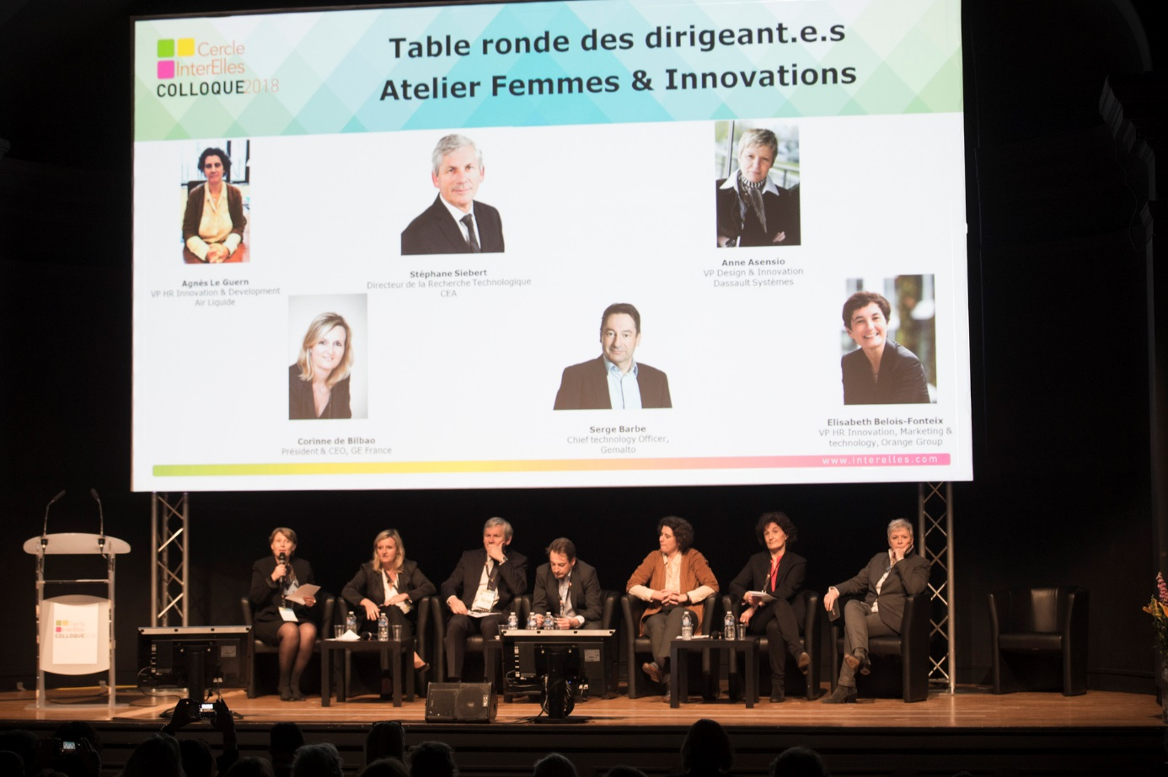
CEO COMMITMENT

Slide 26

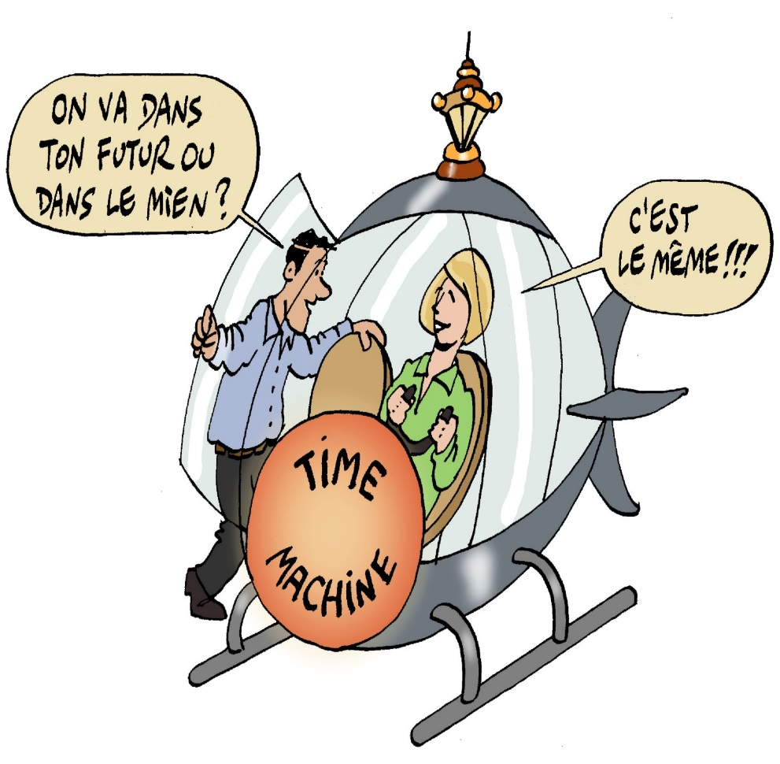

MERCI !

